Slide 1



Real-Time Object Detection and Risk Estimation Using YOLOv8
Sharlene Anna Pereira

Slide 2

Learning Objectives
Learn how deep learning enables road-scene understanding.
Implement real-time object detection using YOLOv8.
Develop a risk estimation mechanism based on detected objects.
Visualize results with bounding boxes and safety colors.
Analyze scene-level risk using automated metrics.
Build a simplified ADAS-style (driver assistance) perception module.
GOAL
Source :
www.freepik.com/

Slide 3
Tools and Technology used
Python 3.10
YOLOv8 (Ultralytics) - Object Detection
OpenCV - Image Processing
NumPy & Pandas - Data Handling
Matplotlib - Risk Analytics
KaggleHub - Dataset Access (IDD)
Gradio - Interactive Web Demo
Google Colab - Execution Environment

Slide 4
Methodology
Dataset Preparation
Downloaded the Indian Driving Dataset (IDD) using KaggleHub.
Selected a subset for evaluation and testing.
Object Detection (YOLOv8) : YOLOv8n model detects road users such as cars, buses, trucks, pedestrians, bicycles, etc.
Risk Estimation
Proximity-based risk calculated using bounding box height.
Vulnerable road users (pedestrians, bicycles, motorcycles) receive additional risk weightage.
Risk Categories:
0–35 → Safe
36–65 → Caution
66–100 → Danger
Annotation & Visualization
Bounding boxes color-coded (Green/Yellow/Red).
Overall scene risk shown as a top banner.
Batch Evaluation & Analytics
Annotated outputs saved for 20+ IDD images.
Generated CSV logs and risk distribution histograms.
Gradio Web App :User uploads an image and receives immediate detection + risk estimation.

Slide 5
Problem Statement:
Road accidents occur frequently due to lack of driver awareness, unpredictable traffic behavior, and high-
density road environments.
Drivers often fail to recognize or react to nearby threats in time.
There is a strong need for an Al-driven perception system that can detect hazards earlier and provide
risk awareness.

Slide 6
Solution:
The system provides a real-time Al-based safety assistant by:
• Using YOLOv8 to detect objects on the road
• Estimating risk based on object proximity and vulnerability
• Highlighting hazardous objects with high-risk colors
• Generating an overall risk score for each scene
• Giving the user an easy-to-understand safety assessment
This forms the foundation of an intelligent ADAS (Advanced Driver Assistance System).

Slide 7
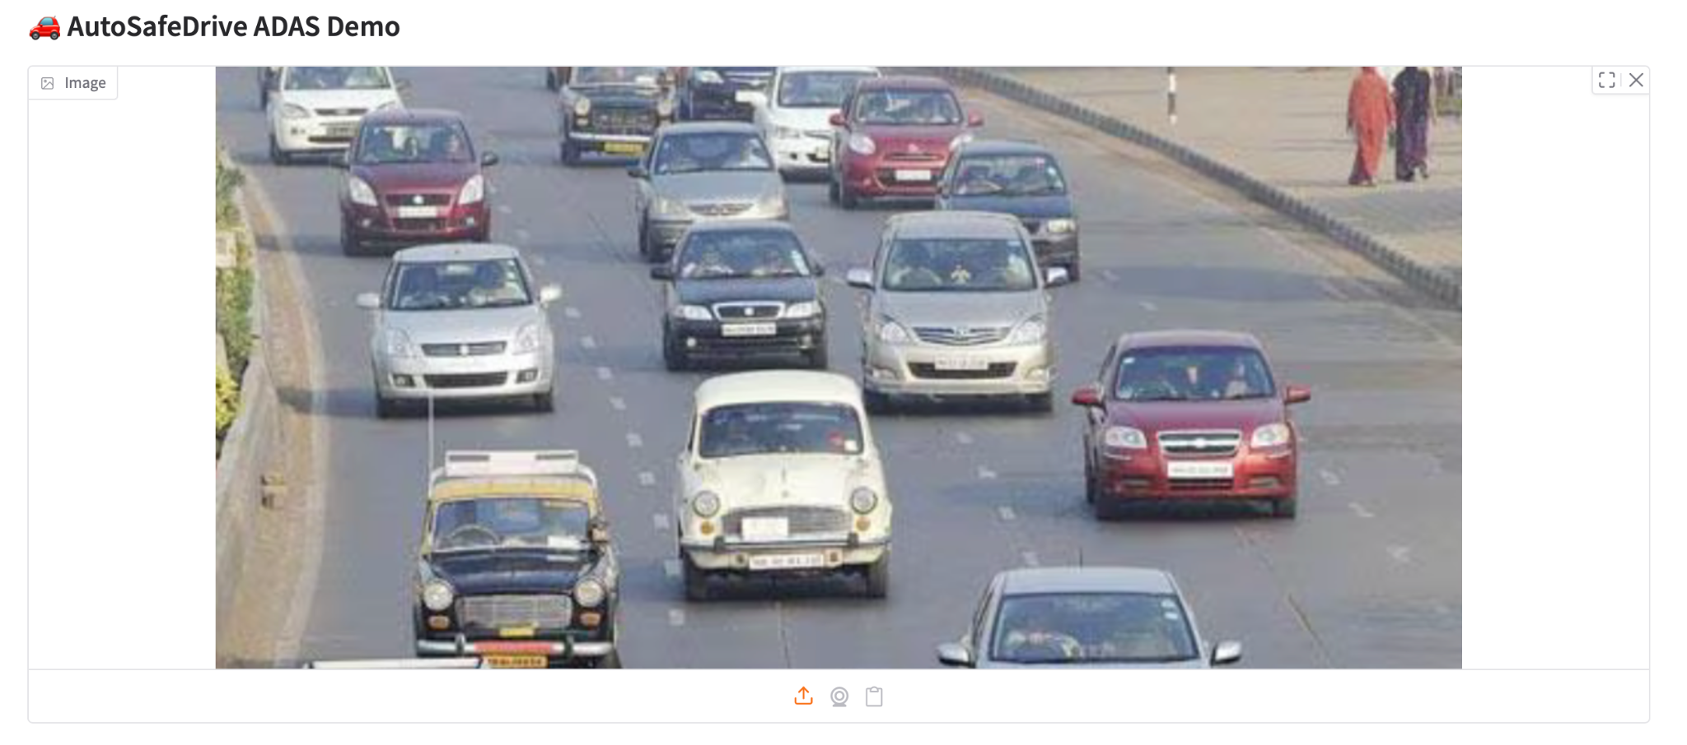
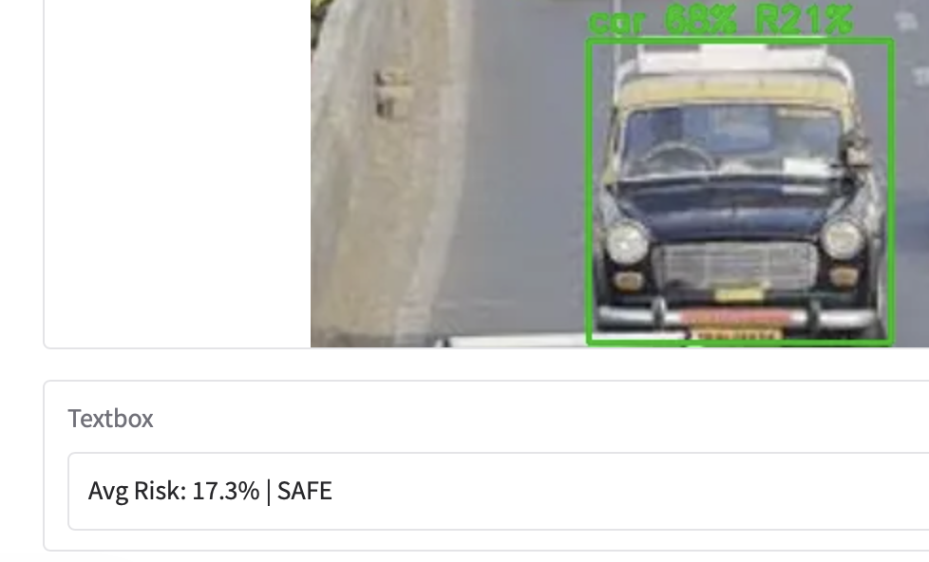
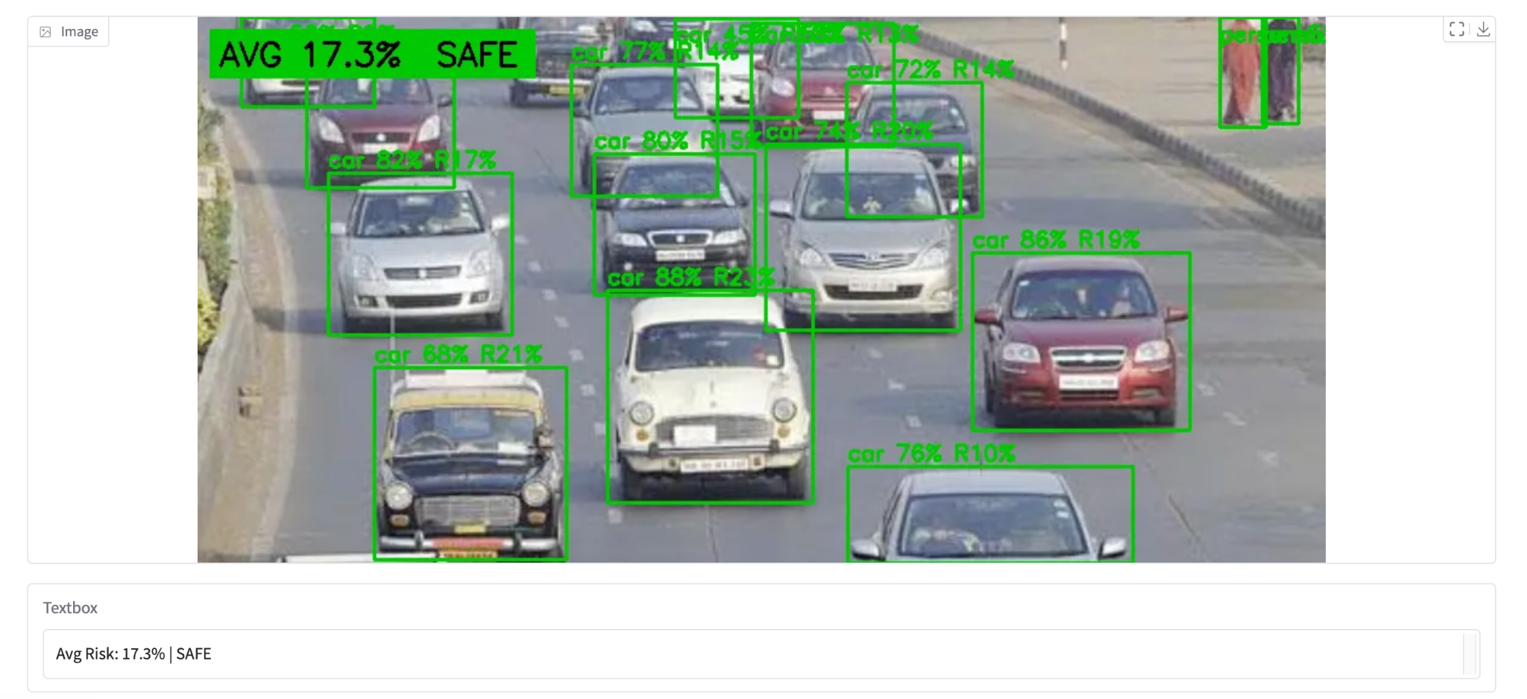
Screenshot of Output:
Output Screenshots contain 3 images:
Original Road Scene (Input)
Annotated Detection Output (YOLOv8)
Overall Safety Status – Risk Estimation

Slide 8
Conclusion:
YOLOv8 accurately detects multiple road users in real time.
The risk engine estimates scene-level danger effectively using proximity and vulnerability logic.
The system produces clear, interpretable safety visualizations suitable for ADAS-style applications.
Batch evaluation and analytics provide insights into risk distribution across traffic scenes.
The interactive Gradio interface makes the model easy to test and demonstrate.
This project lays strong groundwork for advanced ADAS features like driver monitoring, lane tracking,
and collision prediction.

